Slide 1
PSE Summer Module 1 - Overview of Zero Knowledge Proofs
PSE Summer Module 1 - Overview of Zero Knowledge Proofs
Presented by Jason
Date: Aug. 02, 2023
Group: MACI
Presented by Jason
Date: Aug. 02, 2023
Group: MACI

Slide 2
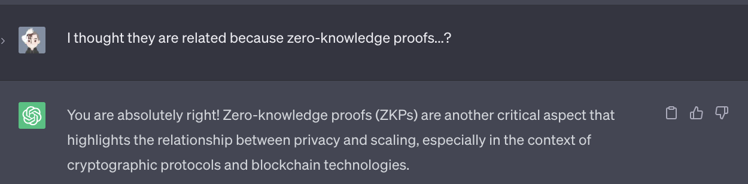
Privacy & Scaling Explorations
How are privacy and scaling related?
ChatGTP: “As systems and platforms scale up, meaning they handle larger volumes of data and users, privacy concerns become more significant and complex.”

Slide 3
Privacy
As an informal definition, ZKP allow one party (the prover) to demonstrate the truth of a statement to another party (the verifier) without revealing any additional information apart from the fact that the statement is true.
Use-cases include anonymous payments, DIDs, Over 18 ZKRP, electronic voting, etc.
Note that ZKP are proofs of “knowledge”, not proofs of truth.
Notes:
ZKRP for“zero-knowledge range proof”

Slide 4
Scaling
There are different solutions for scaling.
On-chain solutions require extensive modification of the blockchain’s base layer.
Off-chain solutions rely on an outsourced computation model to improve throughput, and Ethereum only needs to apply the computation results to its state.
In the off-chain scheme, ZKP can assist with validating off-chain transactions without re-executing them.

Slide 5
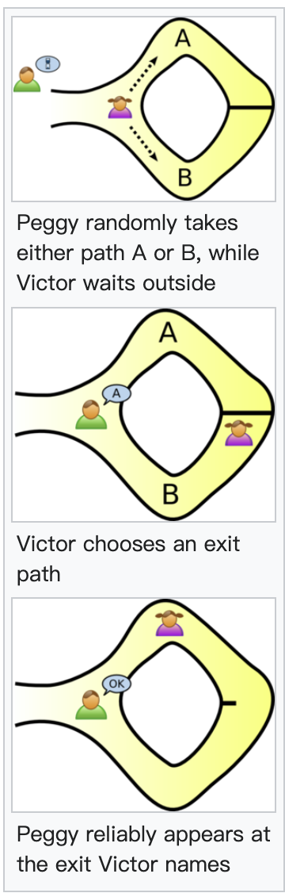
The Ali Baba Cave – Abstract Example
If Peggy knows the magic word, she can always success.
If Peggy doesn’t know the secret word, she will fail after many trails.
Victor can never know the secret word.

Slide 6
ZKP Property
A ZK protocol must satisfy the following criteria:
Completeness: If the prover has proper knowledge, his proof can be accepted by the verifier.
Soundness: If the prover has no proper knowledge, his proof can not be accepted by the verifier.
Zero-knowledge: The proof reveal nothing more than “this statement is true”.

Slide 7

ZKP Property
A ZK protocol must satisfy the following criteria:
Completeness: If the prover has proper knowledge, his proof can be accepted by the verifier.
Soundness: If the prover has no proper knowledge, his proof can not be accepted by the verifier.
Zero-knowledge: The proof reveal nothing more than “this statement is true”.
$$symmetric$$

Slide 8

ZKP Property
A ZK protocol must satisfy the following criteria:
Completeness: If the prover has proper knowledge, his proof can be accepted by the verifier.
Soundness: If the prover has no proper knowledge, his proof can not be accepted by the verifier.
Zero-knowledge: The proof reveal nothing more than “this statement is true”.
$$symmetric$$

Slide 9
ZKP Property
A ZK protocol must satisfy the following criteria:
Completeness: If the prover has proper knowledge, his proof can be accepted by the verifier.
Soundness: Protect the verifier from being cheated.
Zero-knowledge: Protect the prover from information leakage.
$$symmetric$$
→ trust issue → scaling issue
→ privacy issue

Slide 10
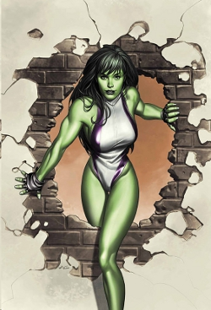
The Ali Baba Cave – What If... ?
Peggy is She-Hulk?
We can prove the zero-knowledge(ness).

Slide 11
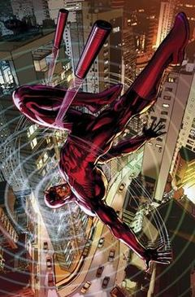
The Ali Baba Cave – What If Else... ?
Victor is Daredevil?
We can prove the soundness.

Slide 12
The Ali Baba Cave – What Else... ?
Peggy just goes in through A and comes out from B?
The 3rd party will be sure about Peggy’s knowledge.

Slide 13
Interactive vs. Non-Interactive
“Interactive” means interact more than once.
“Non-interactive” means interact only once.
ZK-SNARK (Zero-Knowledge Succinct Non-Interactive Argument of Knowledge)
ZK-STARKs (Zero-Knowledge Scalable Transparent Argument of Knowledge)

Slide 14
Let’s Do Some Math.

Slide 15



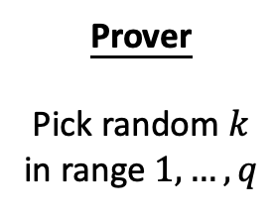
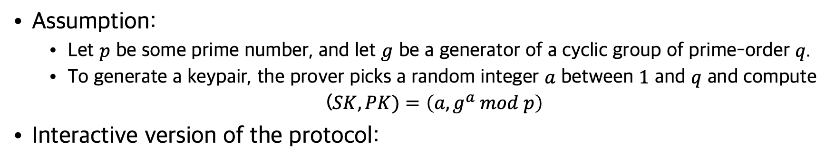

Schnorr’s Protocol
Assumption:
Let $p$ be some prime number, and let $g$ be a generator of a cyclic group of prime-order $q$.
To generate a keypair, the prover picks a random integer $a$ between $1$ and $q$ and compute
($SK, PK)=\left(a, g^{a} mod p\right)$
Interactive version of the protocol:
Prover
Pick random $k$
in range $1,…,q$
Verifier
Pick random $c$
in range $1,…,q$
Check that:
$$g^{z}≡_{p}{PK}^{c}∙h$$
$${h=g}^{k }mod p$$
$$c$$
$$z=ac+k mod q$$

Slide 16
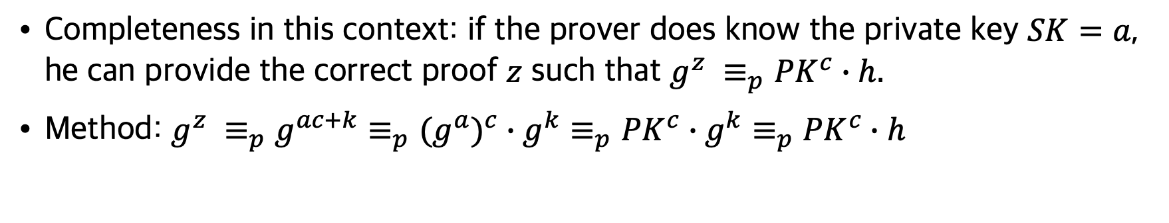
Proving the Completeness
Completeness in this context: if the prover does know the private key $SK=a$, he can provide the correct proof $z$ such that $g^{z} ≡_{p}{PK}^{c}∙h.$
Method: $g^{z} {≡_{p}g}^{ac+k}≡_{p}(g^{a})^{c}∙g^{k}≡_{p}{PK}^{c}∙g^{k}≡_{p}{PK}^{c}∙h$
Prover
Pick random $k$
in range $1,…,q$
Verifier
Pick random $c$
in range $1,…,q$
Check that:
$$g^{z}≡_{p}{PK}^{c}∙h$$
$${h=g}^{k }mod p$$
$$c$$
$$z=ac+k mod q$$

Slide 17




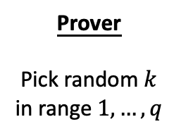



Proving the Soundness
Soundness in this context: if the prover doesn’t know the private key $SK=a$, he cannot provide the correct proof $z$ such that $g^{z} ≡_{p}{PK}^{c}∙h.$
Method: use an extractor (i.e. Daredevil) to recover the prover’s knowledge.
Prover
Pick random $k$
in range $1,…,q$
Verifier
Pick different random
$c_{1},c_{2}$ in range $1,…,q$
Extract the secret by
$$a≡_{q}(z_{1}−z_{2})/ (c_{1}−c_{2})$$
$${h=g}^{k }mod p$$
$$c_{1}$$
$$z_{1}=a(c_{1})+k mod q$$
Rewinds to Step2
$$c_{2}$$
$$z_{2}=a(c_{2})+k mod q$$
Notes:
This scheme is used in real world attack, when the randomness in the cryptography algorithm is violated.

Slide 18



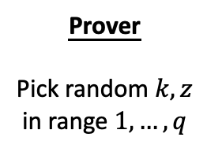

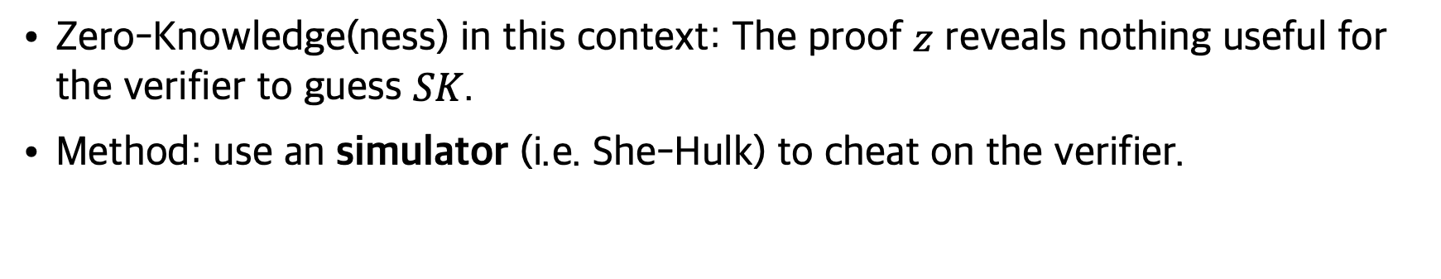

Proving the Zero-Knowledge(ness)
Zero-Knowledge(ness) in this context: The proof $z$ reveals nothing useful for the verifier to guess $SK$.
Method: use an simulator (i.e. She-Hulk) to cheat on the verifier.
Prover
Pick random $k, z$
in range $1,…,q$
Verifier
Pick random $c$
in range $1,…,q$
Check that:
$$g^{z}≡_{p}{PK}^{c}∙h′$$
$${h=g}^{k }mod p$$
$$c$$
Rewinds to Step1
$${h′=g}^{z}∙g^{a(−c)} mod p$$
$$c$$
$$z$$
$${PK}^{c}∙h^{′}≡_{p}{PK}^{c}∙g^{z}∙g^{a(−c)}≡_{p}(g^{a})^{c}∙g^{z}∙g^{a(−c)}{≡_{p}g}^{z}$$
Notes:
If the simulator succeed, we therefore prove that the proof must contain no knowledge, since the simulator itself does not have the knowledge.

Slide 19
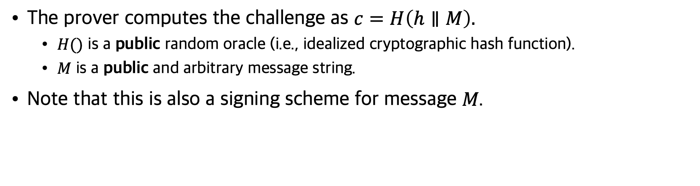


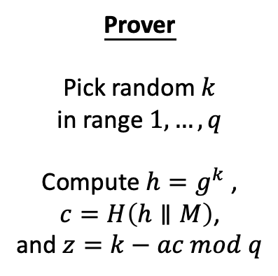
Non-Interactive Version
The prover computes the challenge as $c=H\left(h∥M\right).$
$H()$ is a public random oracle (i.e., idealized cryptographic hash function).
$M$ is a public and arbitrary message string.
Note that this is also a signing scheme for message 𝑀.
Prover
Pick random $k$
in range $1,…,q$
Compute $h=g^{k}$ ,
$$c=H\left(h∥M\right)\text{,}$$
and $z=k−ac mod q$
Verifier
Compute
$$c=H\left(h∥M\right)$$
Check that:
$$h≡_{p}{PK}^{c}∙g^{z}$$
$$(c, z)$$
$${h≡_{p}g^{k} ≡}_{p}{{(g^{a})^{c}∙g}^{k−ac} ≡}_{p}{{(g^{a})^{c}∙g}^{z} ≡}_{p}{PK}^{c}∙g^{z}$$
Notes:
https://www.cryptologie.net/article/193/schnorrs-signature-and-non-interactive-protocols/

Slide 20
“... (with the advent of social media) All of a sudden people felt I can share everything with everyone, and I feel that now we’re seeing the repercussions of that... Basically things that previous generation learned, this generation is now learning ‘oh wait, sharing everything, there are problems with that, there are unforeseen consequence of having all of your information out there.’” —— ZKPodcast (31:00)

Slide 21
Reference
A survey on zero knowledge range proofs and applications
What are zero-knowledge proofs?
探索零知识证明系列1 - 初识「零知识」与「证明」
ZKPodcast: Dan Boneh on the past, present & future of cryptography
Zero Knowledge Proofs: An illustrated primer
Schnorr's Signature and non-interactive Protocols

